Slide 1
Power BI Overview
Munish Arora
Power BI Overview
Overview of Power BI

Slide 2
Power BI Overview
What is Power BI
Architecture
Power BI Desktop
Data Sources (SQL Server, Sharepoint, etc.)
Tour of Power BI

Slide 3

Lesson 1: Data Analytics and Microsoft

Slide 4
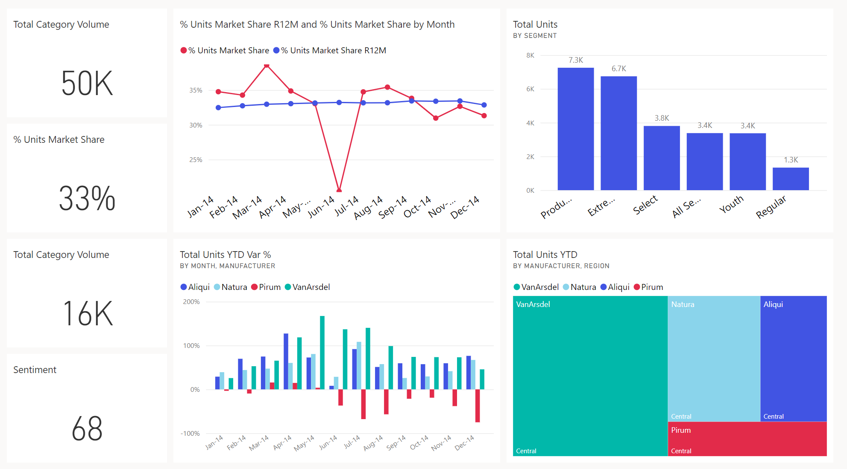



















Introduction
Data and information is the most strategic business asset.

Slide 5
Overview of Data Analysis
What is likely to happen in the future based on previous trends and patterns?
Determine best course of action to choose to bypass or eliminate future issues
Combines different technologies like artificial intelligence, machine-learning algorithms,
What is happening in my business?
Why it is happening in your business
Descriptive
Diagnostic
Predictive
Prescriptive
Cognitive
Descriptive analytics helps answer questions about what has happened, based on historical data
Diagnostic analytics techniques take the findings from descriptive analytics and dig deeper to find the cause.
Predictive analytics techniques use historical data to identify trends and determine if they're likely to recur.
Prescriptive Analysis, use insights from predictive analytics, data-driven decisions can be made.
What might happen if circumstances change and how you might handle these situations, derive conclusions based on existing knowledge bases

Slide 6
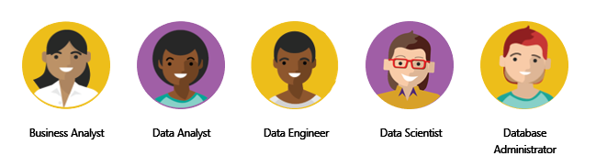
Roles in Data Analysis
Profiling, cleaning, and transforming data, designing, and building data models, and enabling and implementing the advanced analytics capabilities into reports for analysis.
PL-300
DP-203
DP-100
DP-300
Use of on-premises and cloud data services and tools to take, sending out, and transform data from multiple sources
A business analyst is closer to the business itself and is a specialist on interpreting the data that comes from the visualization.
Perform advanced analytics to extract value from data. Work can vary from descriptive analytics to predictive analytics.

Slide 7
Tasks of a Data Analyst
Bring your data to life by creating visualizations in report
Interpret information that is displayed on the report
Manage reports, dashboards,workspaces, datasets, and much more.
Connecting With Raw Data
How tables are related to each other
Prepare
Model
Visualize
Analyze
Manage
Model has a vital impact on application reporting and data analysis
It involves profiling, cleaning and transforming the data in understandable format
This data is thereafter used in model and visualize.
define, and create relationships among the tables.
Thereafter, enhance the model by defining metrics and adding custom calculations to enrich your data.
Using appropriate visualizations and interactions, an effective report guides the reader through the content quickly and efficiently
Use analytical capabilities of Power BI to find insights, identify patterns and trends, predict outcomes, and then communicate those insights in such a way that everyone can understand.
Management of Power BI assets as listed above, overseeing the sharing and distribution of items such as reports and dashboards, and ensuring the security of Power BI assets.

Slide 8
Knowledge Check
Q01 – Which data role enables advanced analytics capabilities through reports and visualizations?
A01 – Data Analyst
Q02 – Which data analyst task has critical performance impact on reporting and data analysis?
A02 – Model
Q03 – What is a key benefit of data analysis?
A03 – Informed business decisions.

Slide 9
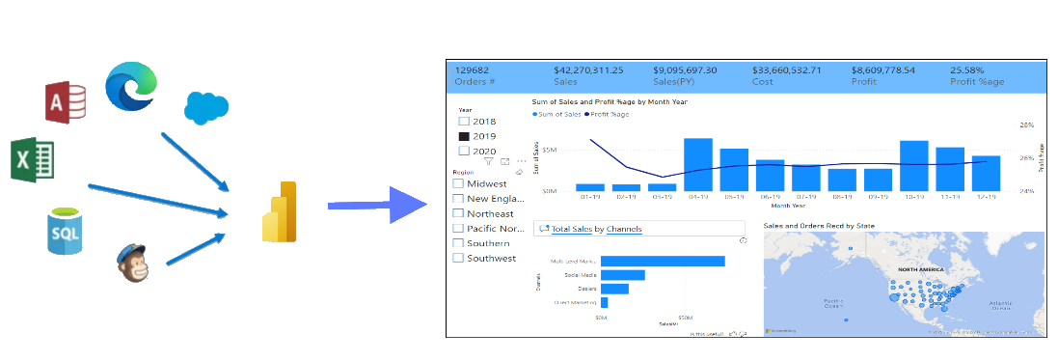
What is Microsoft Power BI
Power BI is a collection of software, services, apps, and connectors.
It Provides interactive visualizations with self-service BI capabilities , where end users can create reports and dashboards by themselves, without having to depend on any IT and Database administration.

Slide 10
What is Microsoft Power BI
Power BI is a collection of software, services, apps, and connectors.
It Provides interactive visualizations with self-service BI capabilities , where end users can create reports and dashboards by themselves, without having to depend on any IT and Database administration.

Slide 11
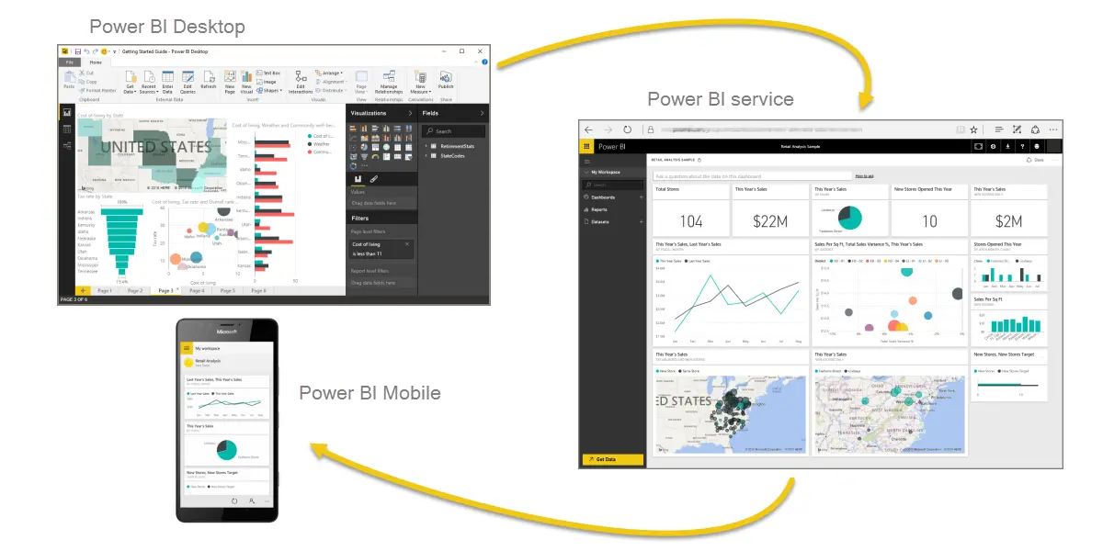
Parts of Power BI
Power BI consists of
A Microsoft Windows desktop application called Power BI Desktop
An online SaaS (Software as a Service) service called the Power BI service and
Mobile Power BI apps that are available on any device, with native mobile BI apps for Windows, iOS, and Android.

Slide 12
Common Flow Of Activity
The common flow of activity in Power BI looks like this:
Bring data into Power BI Desktop
Create a report
Publish to the Power BI service
In Power BI Service, you can create new visualizations or build dashboards.
Share dashboards with others, especially people who are on the go.

Slide 13
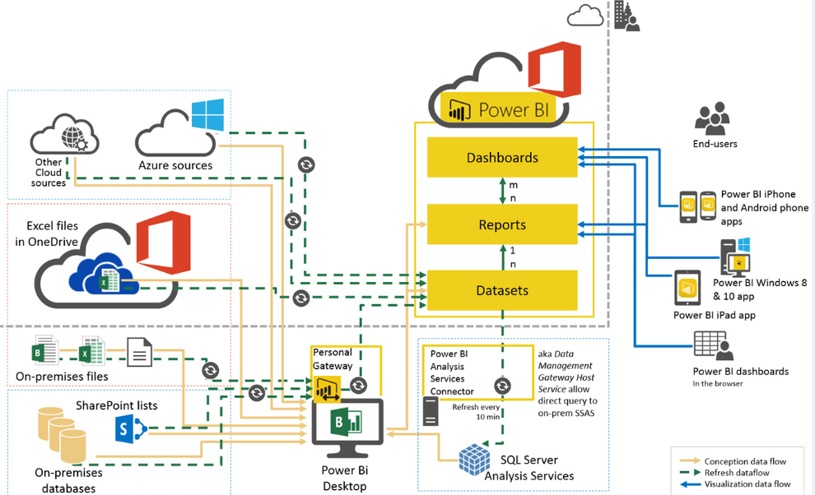
Architecture
A dataset is a collection of data that you import or connect to.

Slide 14
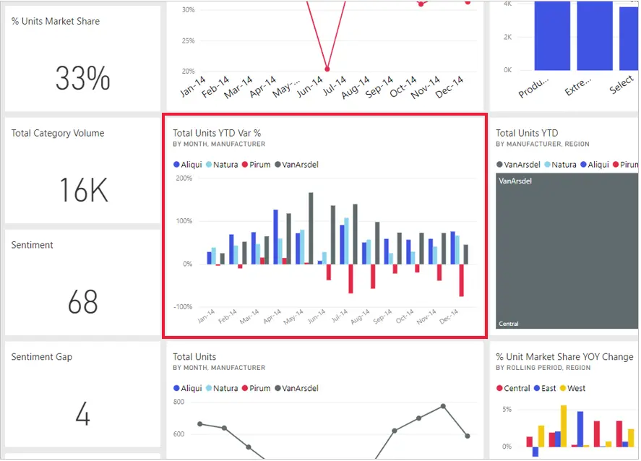
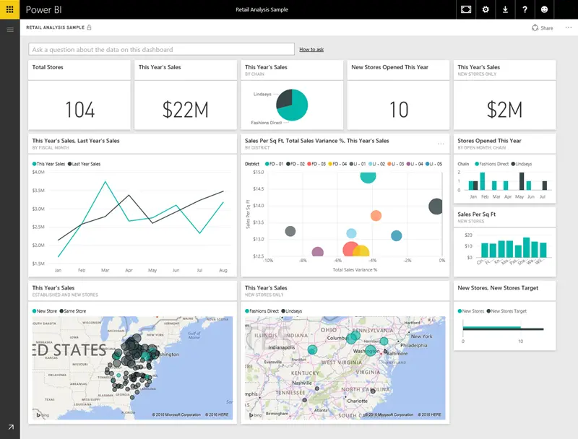
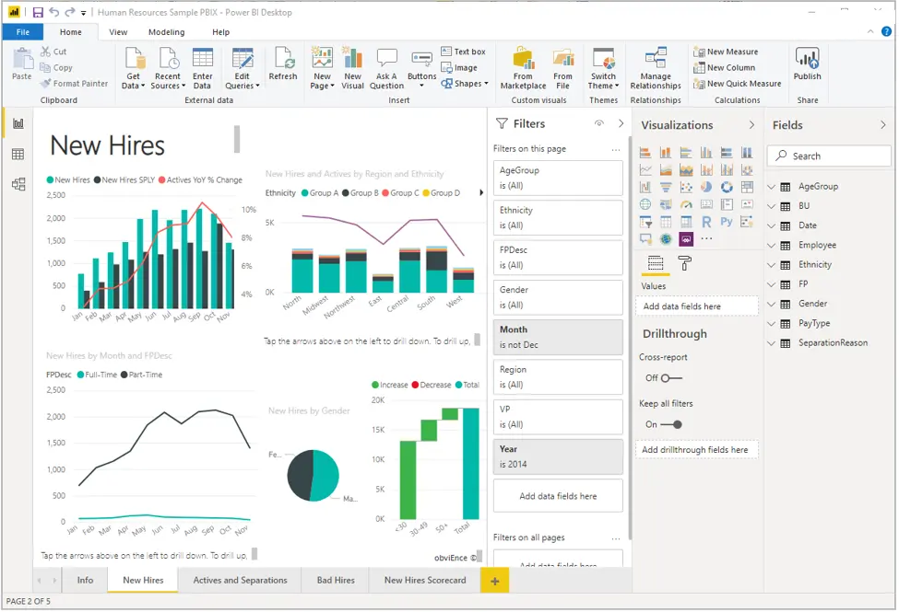
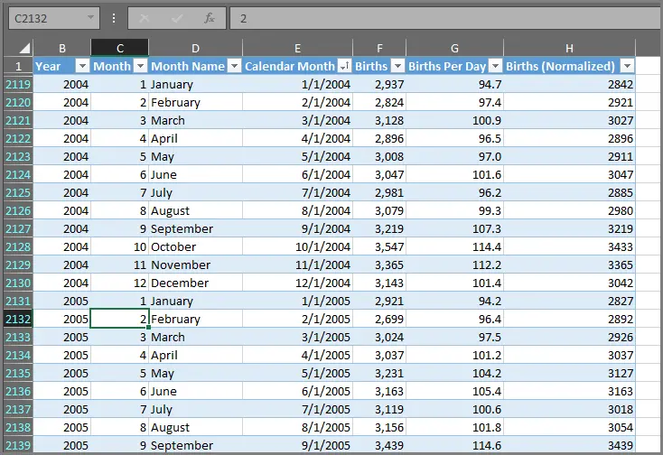
Building Blocks of Power BI
Visualizations
Sometimes also referred to as a visual, it is a visual representation of data, like a chart, a color-coded map
Dashboard and Tiles
Collection of visuals from one or more reports
Datasets
A collection of data from a combination of many different sources which is used to create visualizations.
Reports
A collection of visualizations that appear together on one or more pages.

Slide 15
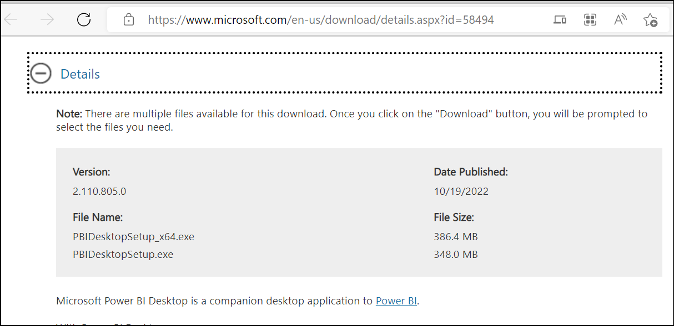
Power BI Desktop
Power BI Desktop is a free tool and can be downloaded from https://www.microsoft.com/en-us/download/details.aspx?id=58494

Slide 16
Power BI Desktop
When you start Power BI Desktop, you will see pane in LHS, via which you can switch between Report, Data and Model
Ribbon at Top, via which you can do various operations like getting data, adding calculated fields / measures, and Publishing etc.
Note: Ribbon changes as you switch between options in LHS pane.
Visualization section for selecting visuals
Tables and their corresponding fields in Fields tab
Model shows relationships amongst various tables

Slide 17
Touring and Using Power BI

Slide 18
Knowledge Check
Q01 – Which of these are building blocks of Power BI?
A. Visualizations B. Datasets C. Reports D. Dashboards and Tiles
A01 – Visualizations, Datasets, Reports, Dashboards, and Tiles
Q02 – What is the common flow of activity in Power BI?
Bring data into Power BI Desktop
Create a report
Publish to the Power BI service
In Power BI Service, you can create new visualizations or build dashboards.
Share dashboards with others, especially people who are on the go.

